Slide 1

JAVA PROJECT
CAR RENTAL
FLEET MANAGER
student name: k.sai kaushik
roll no: 2620040013
student name: A.kumar
roll no: 2620030137
student name: Arigala Vaibhav
roll no: 2620030557
Notes:
Welcome everyone. This presentation walks through our Car Rental Fleet Manager, demonstrating how six curriculum units connect into one complete production Java application.

Slide 2
abstract
The Car Rental Fleet Manager is a software application designed to simplify and automate the management of vehicles, customers, rentals, and returns in a car rental business. Traditional car rental management methods often rely on manual records, which can be time-consuming, error-prone, and difficult to maintain. This system provides a centralized platform for efficiently managing the rental fleet and customer information.
The system allows rental staff to add, update, search, and remove car records and maintain details such as car name, model, registration number, rental price, availability, and condition. It also manages customer information and maintains rental and return records. Users can easily search for available cars and view relevant information before making a rental request. The system can track rental periods, return dates, and vehicle availability, helping staff manage the fleet efficiently and avoid booking unavailable vehicles.
By automating routine operations, the proposed system reduces paperwork, minimizes data-entry errors, saves time, and improves accessibility of vehicle information. It also provides an organized and reliable method for maintaining rental records and monitoring the overall fleet. The Car Rental Fleet Manager can be implemented as a web or desktop application and can be further enhanced with features such as online booking, automatic billing, payment processing, late-return charges, maintenance tracking, and role-based access. Overall, the system aims to provide a simple, efficient, and user-friendly solution for managing car rental operations and fleet activities

Slide 3
problem statement
Managing a large number of rental cars manually can be difficult and time-consuming.It can be challenging to keep track of car names, rental prices, and availability. Manual records may lead to data-entry errors and incorrect availability information. Customers need an easy way to search for cars and check whether they are available. Rental staff need a simple system to add, display, rent, return, and search cars. Therefore, a Car Rental Fleet Manager is proposed to organize and simplify these operations.

Slide 4

CURRICULUM ARCHITECTURE
ONE JAVA PROJECT, SIX UNITS
CO1 through CO6 each add a functional tier to the fleet management system, from console calculations to reactive data streams.
CO1 & CO2 · Core Engine: Primitive pricing formulas, console receipts, and validation branches.
CO3 & CO4 · Vehicle Domain: Modular fleet arrays, inventory search, and Car entity classes.
CO5 & CO6 · Scale & Persistence: OOP hierarchies, stream pipelines, and file storage.
Notes:
Outline how every learning outcome contributes a tangible feature to the manager instead of remaining an isolated code exercise.

Slide 5
CO1
JAVA BASICS POWER THE RENTAL RECEIPT
Program Structure
Primitive Types
Variables & Constants
Operators
Java program structure: main method, imports, and compilation flow.
int days, double rates, boolean insured.
Arithmetic, relational, logical, assignment, and unary operators.
Variables, constants, identifiers, and literals; final double TAX_RATE.
Expression Evaluation
Scanner / Console Input
Console Output
Operator precedence in daily rate calculations.
Scanner reads customer name and booking duration interactively.
System.out.print() / System.out.println() format the rental receipt.
Notes:
CO1 introduces fundamentals through a concrete deliverable: generating a printed invoice from user inputs.

Slide 6
CO2
CONTROL FLOW DRIVES BOOKING DECISIONS
BRANCHING
ROUTING
ITERATION
VALIDATION
if, if-else, if-else-if
switch, default, break
for loop
do-while loop
Project daily rate breakdowns and calculate multi-week amortized rental charges.
Trap interactive menu selections, repeatedly prompting until valid input is received.
Evaluate driver eligibility, tier qualifications, and seasonal discount triggers.
Map category codes directly to SEDAN, SUV, or TRUCK base rates with strict break flow.
Notes:
CO2 implements system decision-making: validating driver age, selecting vehicle tiers, and driving the interactive console menu.

Slide 7
CO3
METHODS AND ARRAYS ORGANIZE THE FLEET
ARCHITECTURE
SIGNATURES
INVENTORY
DISCOVERY
Modular Code
Method Contracts
1D Fleet Arrays
Search & Count
Decompose terminal logic into decoupled calculate, validate, and print subroutines.
Define reusable parameters and clean return types for pricing algorithms.
Store fixed car plate indices and traverse available parking bay allocations.
Linear scan for available license plates and tally rented vs depot vehicles.
Notes:
Here we transition from single-vehicle scripts to managing collections of cars using structured 1D arrays and clean utility methods.

Slide 8
CO4
CLASSES AND OBJECTS MODEL EVERY CAR
BLUEPRINTS
INSTANTIATION
Car Class & Fields
Constructors
Group vehicle license, model, daily rate, and availability into clean object state.
Enforce initial vehicle setup with parameterized VIN, make, and rate arguments.
FLEXIBILITY
IDENTITY
Overloading & Overriding
The this Keyword
Provide multiple booking methods and custom toString() vehicle summaries.
Disambiguate instance variables from constructor parameters during car registration.
Notes:
CO4 shifts our mindset from procedural arrays to domain modeling, encapsulating state and operations within individual Car instances.

Slide 9

CO5
OOP PILLARS STRUCTURE VEHICLE TYPES
Inheritance & Polymorphism
Vehicle base class; extended by Sedan, SUV, and Truck; invoked uniformly through base references.
Abstraction, Interfaces & Encapsulation
Abstract calculateFare() contracts and interfaces; private rates protected via accessor methods and validation.
Packages
Organized into fleet.model and fleet.service.
Strings & Exceptions
Handle CarUnavailableException cleanly.
Notes:
Demonstrate how OOP principles let our fleet scale: adding electric cars or cargo vans requires zero changes to core rental services.

Slide 10
CO6
GENERICS, STREAMS & FILES MANAGE DATA
CONNECTIONS
GENERICS & ITERATION
STREAM PROCESSING
FILES
Connected fleet data
Filter available cars
Persistent fleet records
Type-safe vehicle lists
Link rental records across the system.
Lambdas, interfaces, streams and collectors process bookings.
Store and retrieve rental data.
Generics, autoboxing and iteration organize fleet data.
Notes:
CO6 provides enterprise capability: dynamic collections, concise functional data manipulation, and persistent disk storage.

Slide 11
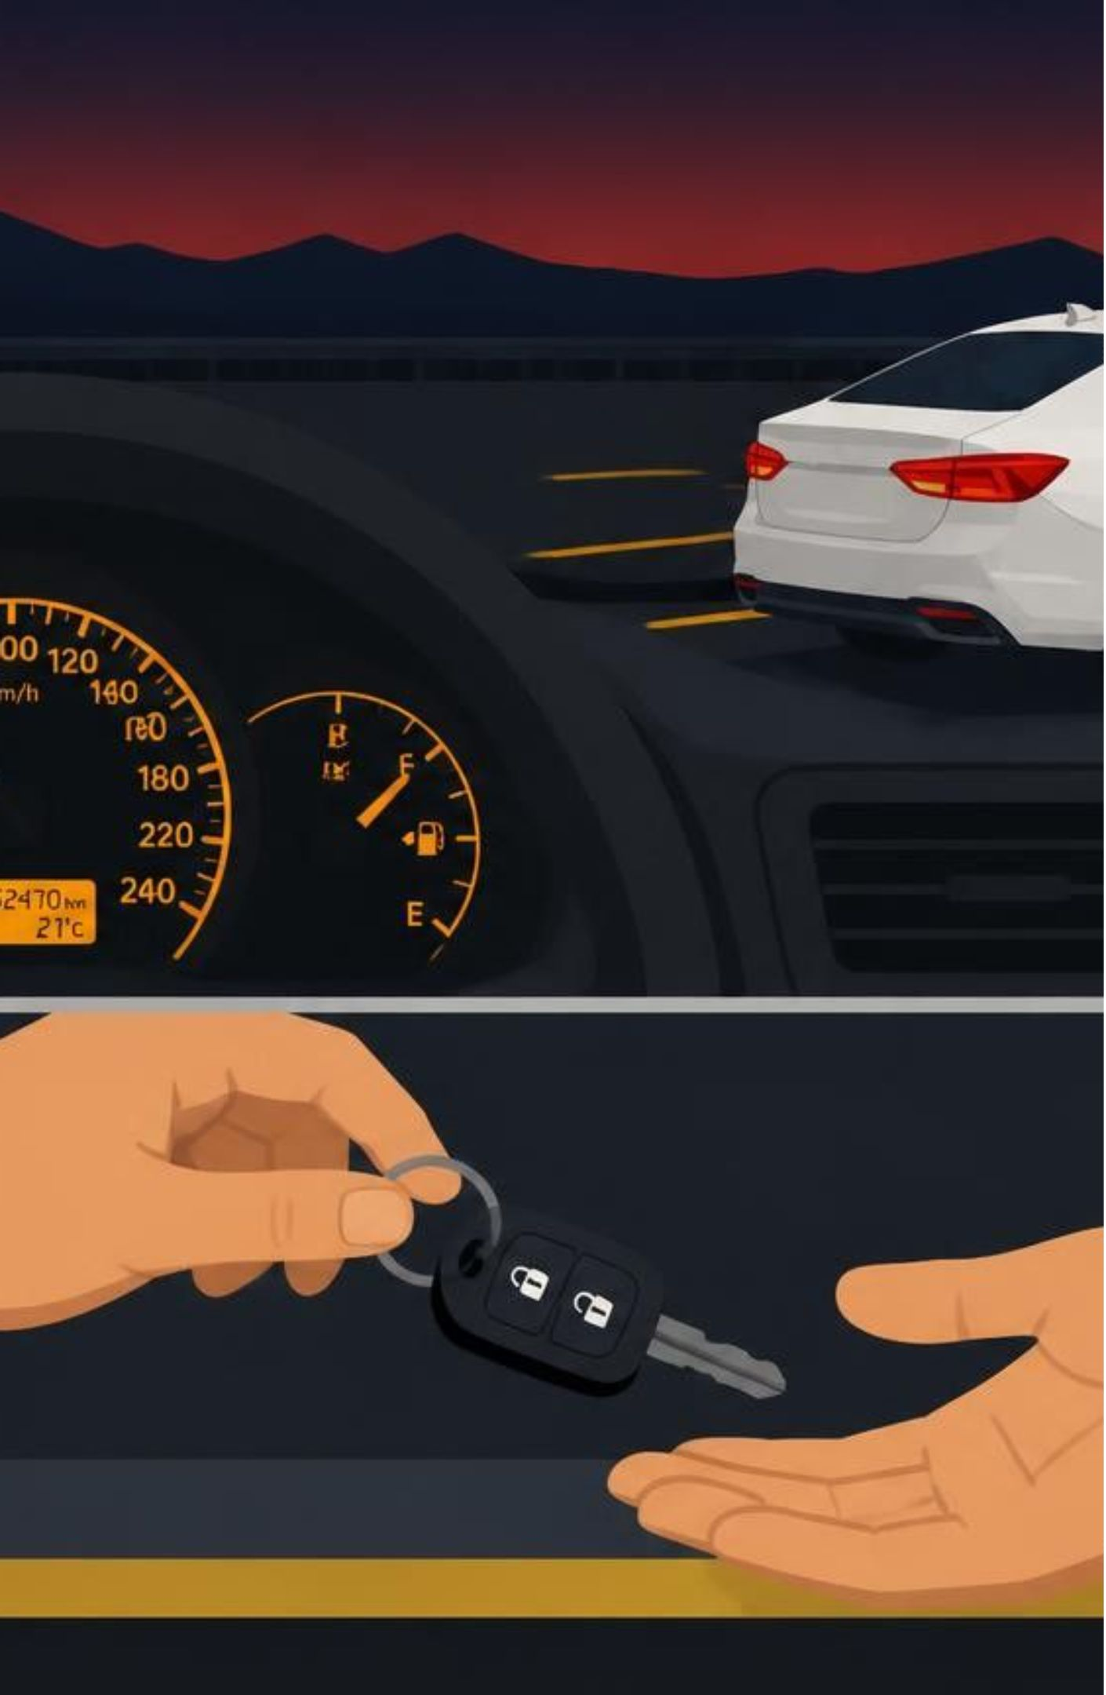
CONCLUSION
HOW THE UNITS FIT TOGETHER
01
Interactive Console & Intake
CO1 & CO2: Scanner input, rate arithmetic, and branching logic validate each driver request.
02
Core Fleet Model & Domain
CO3, CO4 & CO5: Arrays evolve into polymorphic Vehicle hierarchies with custom exceptions.
03
Data Pipelines & Disk Persistence
CO6: Java Streams calculate live analytics while file handlers write CSV transaction logs.
Notes:
Summarize the complete data path: input intake moves to object models, which feed stream pipelines and file persistence.

Slide 12
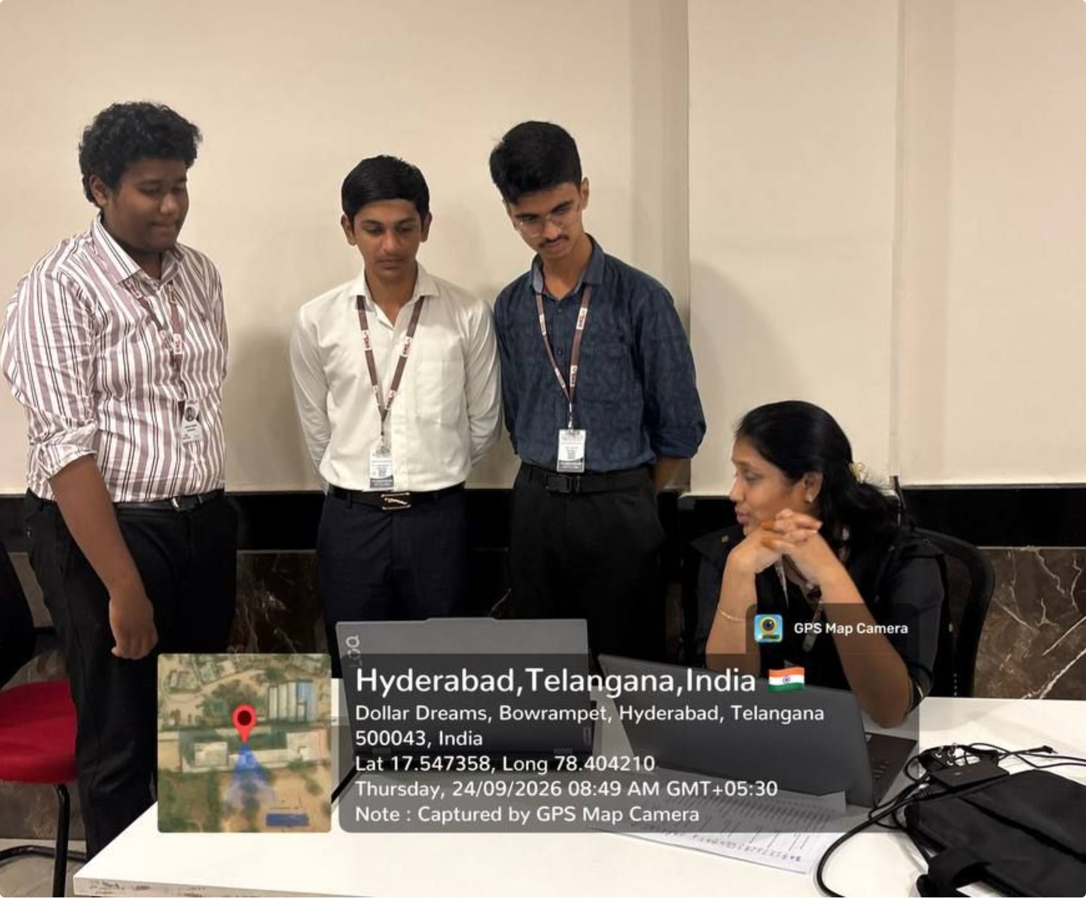
git hub link and geo tag photo
student1: https://github.com/sai-kaushik2008
student2: https://github.com/Vijaykumar-2008
student3: https://github.com/arigalavaibhav-stack

Slide 13
PROJECT COMPLETE
READY FOR THE ROAD
Six units synthesized into one robust, extensible fleet manager.
Questions & Live Code Demo
GitHub repository and Javadoc documentation available upon request.
Notes:
Conclude the presentation, thank the panel and professors, and invite questions along with opening the live demo.

